Slide 1


SOCIAL BUZZ ANALYSIS

Slide 2


Today's agenda
Project recap
Problem
The Analytics team
Process
Insights
Summary

Slide 3

Social buzz is a fast-growing technology unicorn that needs to adapt quickly to its global scale. Accenture has begun a 3-month POC focusing on these tasks:
An audit of Social Buzz's big data practice
Recommendations for successful IPO
Analysis to find Social Buzz's top 5 most popular categories of content.
Project Recap

Slide 4

Problem
Over 100000 post per day
36500000 piece of content per year
How to capitalize this enormous data
Analysis to find Social Buzz's top 5 most popular categories of content.

Slide 5



ANDREW FLEMING
CHIEF TECHNOLOGY ARCHITECT
The Analytics Team
MARCUS ROMPTON
SENIOR PRINCIPAL
R JAYANT
DATA ANALYST

Slide 6
Process
1
DATA UNDERSTANDING
2
DATA CLEANING
3
DATA MODELLING
4
DATA ANALYSIS
5
DATA INSIGHTS

Slide 7

Insights
16
UNIQUE
CATEGORIES
1897
REACTIONS TO
ANIMAL POSTS
JANUARY
MONTH WITH
MOST POSTS

Slide 8
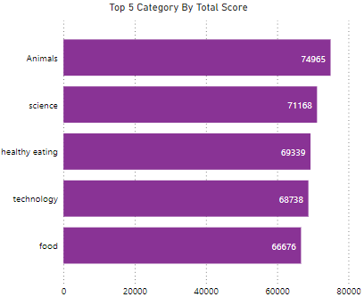

Slide 9
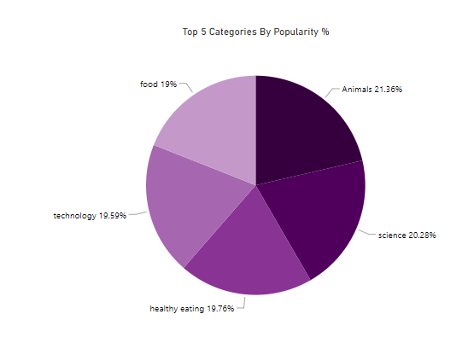

Slide 10

Analysis
Animals and science are the two most popular categories of content, showing that people enjoy "real-life" and "factual" content the most.
Insight
Food is the common theme with the top 5 categories with "Healthy Eating" ranking the highest. This may give an indication to the audience within you user base. You could use this insight to create a campaign and work with healthy eating brands to boost user engagement.
Summary
Next Steps
This ad-hoc analysis is insightful, but its time to take this analysis to large scale production for real-time understanding of your business.

Slide 11
Thank you!
ANY QUESTIONS?

